Slide 1


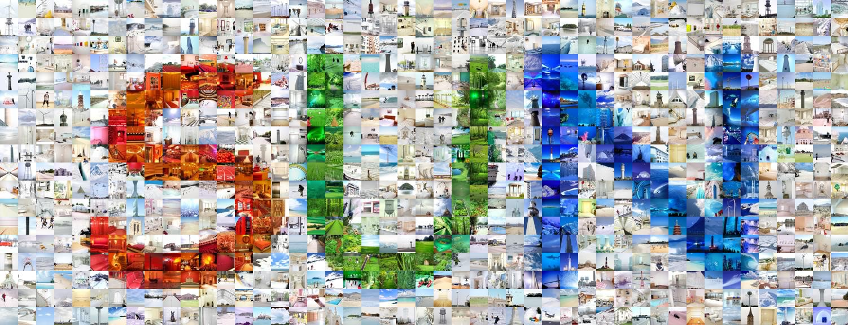
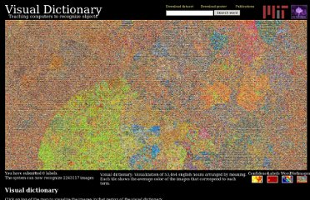
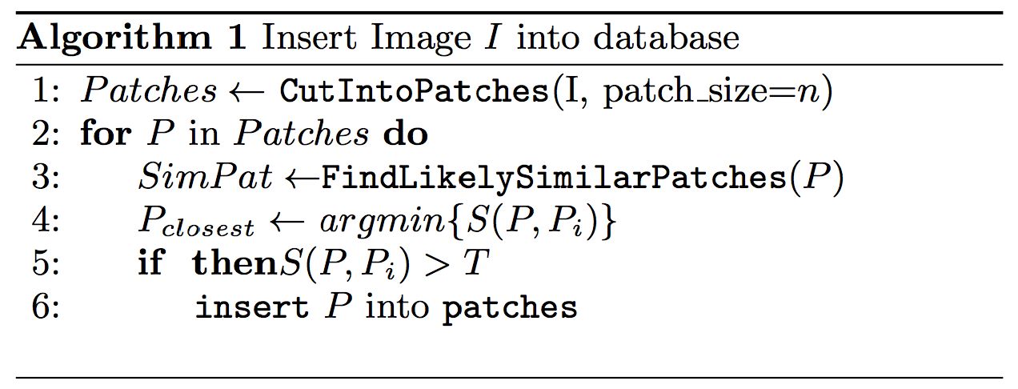
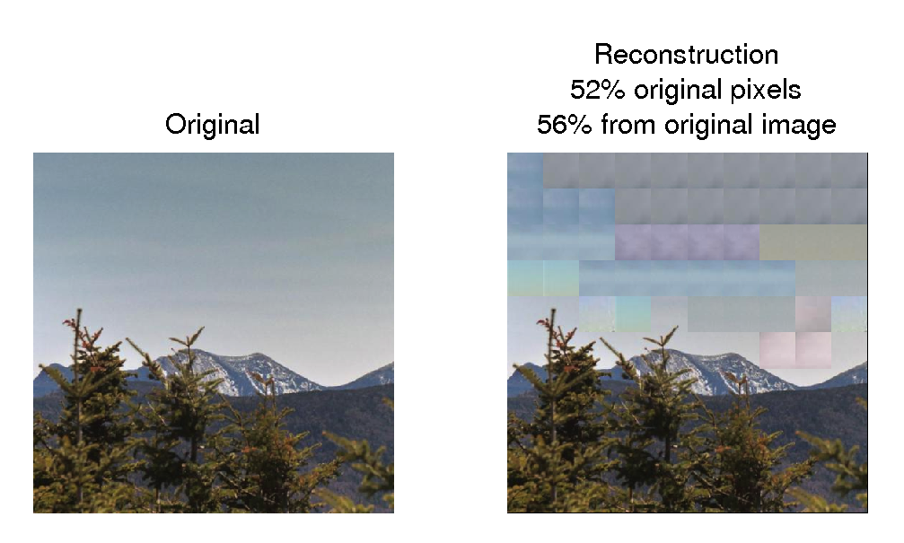
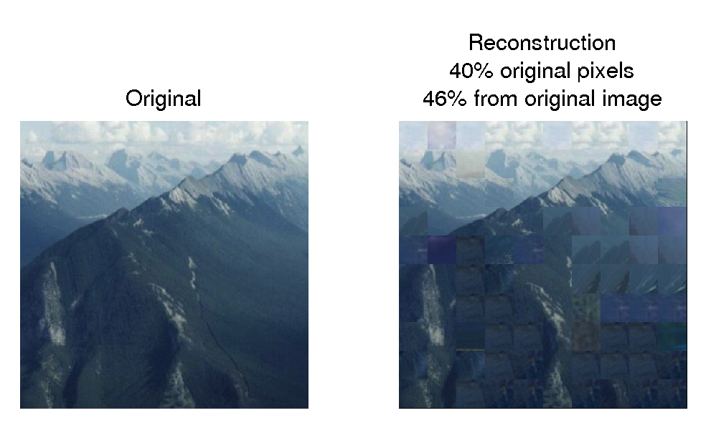
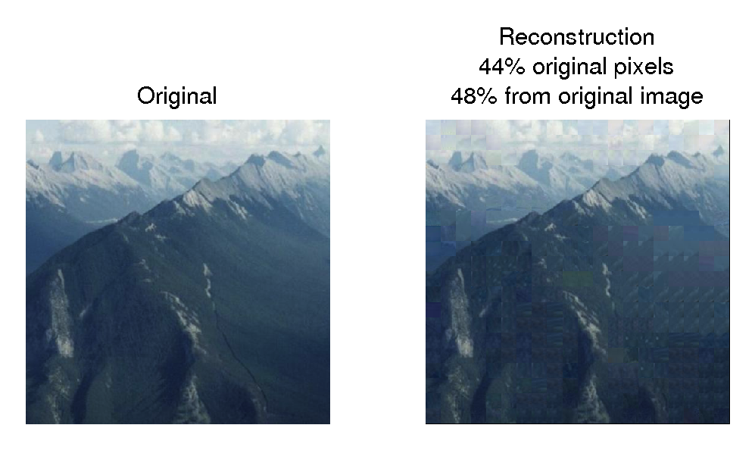
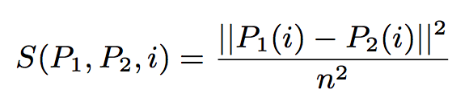
Rasterized Image Databases for Image Compression
6.830
Database Systems
Final Project
Zoya Bylinskii*, Maria Shugrina*, Andrew Spielberg*, Wei Zhao*
MOTIVATION
PARAMETER SELECTION
RESULTS
More than 1.8 billion images uploaded to the internet every day
Redundancy in large image collections can lead to more efficient storage
PATCH-BASED IMAGE CODING
Lossy compression
Compression savings INCREASE as the database size INCREASES
Rasterization is a simple operation – easily deconstruct and reconstruct images using patches
APPLICATIONS
within-image
(e.g. JPEG)
across-image
(our approach)
Compression
Big Data
Big Data
DATABASE SCHEMA
int ID
int ID
images
patch pointers
patches
int img_ID
int patch_ID
[int,int] LOC
bytea PATCH
APPROACH
The importance of the right color space and a thresholding each color channel:
The importance of the right similarity function and threshold:
The importance of the right patch size:
Computing similarity per color channel:
CIE (LUV) color space
Threshold per color channel:

